Slide 1
Stimulating data science research within Jamaica … and other Caribbean Small Island Developing States (SIDS).
Devon K. Barrow University of Birmingham
Lawrence Nicholson University of West Indies

Slide 2
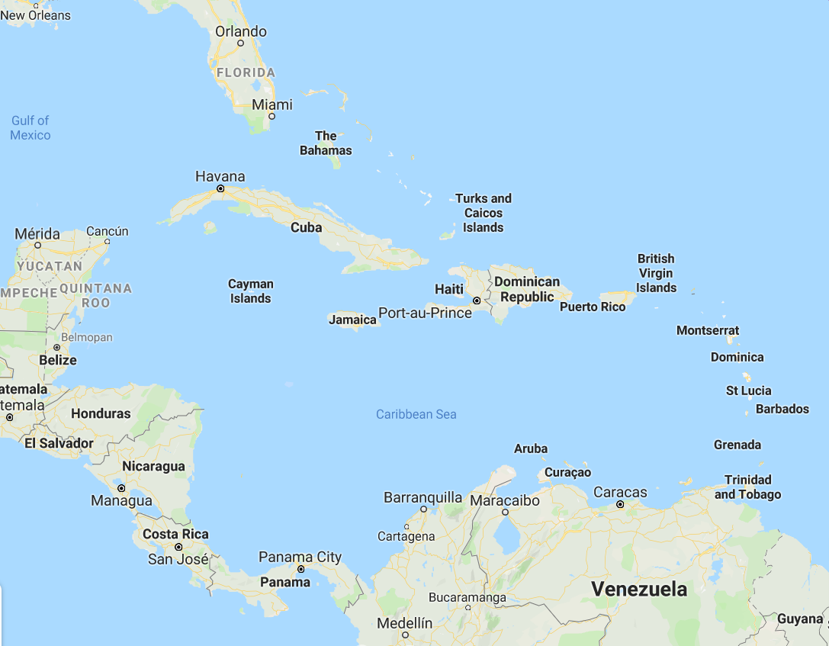

Slide 3
The Caribbean (Small Islands Developing States)
Low- to middle- income countries
This is a list of countries with low-income or middle-income economies. The Organisation for Economic Co-operation and Development (OECD) compiles this information and revises it every three years.
Antigua and Barbuda
Belize
Cuba
Dominica
Dominican Republic
Grenada
Guyana
Haiti
Jamaica
Montserrat
Saint Lucia
Saint Vincent and the Grenadines

Slide 4




Slide 5
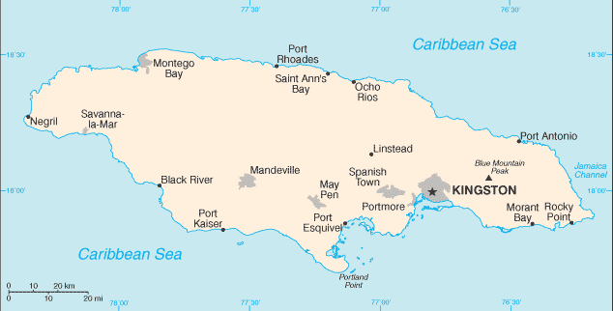
Jamaica Country Profile
Population: 2,812,090 (July 2018 est.)
Literacy: 88.7% | Unemployment: 24.1%
GDP: $US14.77 billion (2017 est.)
Notes
Services, which accounts for more than 70% of GDP.
Remittances and Tourism each account for 14% and 20% of GDP
Economic growth declined to 0.9% in 2017 due to intense rainfall
Approximately 90 percent of Jamaica’s $14 billion GDP is produced within its coastal zone (Tourism, Fisheries, Agriculture)
Source: www.cia.gov , www.worldback.org, www.climatelinks.org

Slide 6

Jamaica Information Technology (ICT) Profile
2012 – 2014 ICT indicators
11.4% of Jamaicans have never used and never heard of broadband internet.
24% of Jamaicans have access to computers, and only 27.4% of that group (approx. 6.5% of the total population) have computers at home.
2.3 out of a possible 7 with regards to the country’s ICT usage and ranked 88th out of 144 countries for the numbers of individuals having access to the Internet (37.8%).
11% use the internet for e-commerce purposes, 8.4% for internet banking.
2017 ICT indicators
Proportion of households with a computer: 36.9%
Proportion of households with Internet access at home: 53.4%

Slide 7
Research proposal

Slide 8

Global Challenge Research Fund (GCRF)
The Global Challenges Research Fund (GCRF) is a £1.5 billion fund announced by the UK Government in late 2015 to support cutting-edge research that addresses the challenges faced by developing countries.
Enhance engagement with Low- and Middle-Income Countries (LMIC): Jamaica
Research Co-Design sandpits
Capacity building fund

Slide 9
Motivation
For small islands the potential for data science to further sustainable development goals and humanitarian action, and improve human well-being is now well understood.
Most vulnerable:
Tourism and agriculture sectors
Climate change
Lag behind in the adoption of information technology
Challenges
High costs of training and technology
Lack of sufficient resources for investment
Limited cooperation among private/public sector and the academic/research community
Jamaica and other SIDS have called for a “data revolution” in the implementation of sustainable development goals [Source: UN Sustainable Development Programme]

Slide 10
Motivation
For small islands the potential for data science to further sustainable development goals and humanitarian action, and improve human well-being is now well understood.
Most vulnerable:
Tourism and agriculture sectors
Climate change
Lag behind in the adoption of information technology
Challenges
High costs of training and technology
Lack of sufficient resources for investment
*** Limited cooperation among private/public sector and the academic/research community ***
Jamaica and other SIDS have called for a “data revolution” in the implementation of sustainable development goals [Source: UN Sustainable Development Programme]

Slide 11

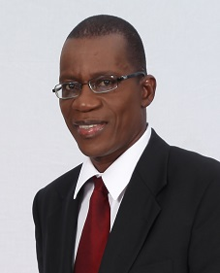
Principle collaboration
University of the West Indies, 501–600 THE World Rankings, 32nd Latin America
23,305 students, 22.2 student/staff ratio, 71:29 females/males
One of only two regional universities in the world.
More than 20 current and former Caribbean Prime Ministers and Heads of State are UWI alumni.
They have produced two of the four Nobel Laureates of Caribbean descent, Derek A. Walcott (Nobel Prize for Literature, 1992) and Sir Arthur Lewis (Nobel Prize for Economics, 1979).
Principle contact:
Mona School of Business and Management
Dr Lawrence Nicholson | Unit Head and Senior Lecturer, Decision Sciences & Information Systems (DSIS)

Slide 12
Aims and objectives
The project will focus on three main themes of data science, (1) education, (2) research and (3) application, and will hope to address the following objectives:
Provide a forum to foster intensive discussions and free thinking in order to uncover innovative solutions to the challenges facing data science education, research and application in the Jamaica and wider Caribbean region.
Establish in the area of data science education, research and application a partnership with the University of the West Indies.
To develop with the University of the West Indies and other stakeholders (including public and private sector organizations) within Jamaica, a set of research proposals geared towards understanding and developing capacity in the area of data science education, research and application within the Caribbean region.

Slide 13
Summary of activities
A two-day ‘sandpit’ style event
Bring together the academic community together with key stakeholders with an interest in data science education, research and application.
Form communities and build networks around themes of education, research and application.
Identify project proposals around the aforementioned themes towards realising (future) collaborative projects.
Identify and present funding opportunities for projects developed across the three main themes.

Slide 14
Summary of activities
An audit of the current state of data science education, research and application for the case of Jamaica.
A series of school visits targeted toward secondary and other tertiary level institutions to foster awareness among young scholars.
A public lecture on data science and digital innovation.

Slide 15
Conclusion
The purpose of this work is to develop collaboration across education and research and to create impact for small island states.
The focus is on Jamaica, but this project also represents a case study for islands of similar characteristics.
Forecasting is likely to form only one strand (but an important one) of the project.
The proposal if accepted will lead to possible collaboration with QFF members.
Keep an eye on this space

Slide 16
Questions
Dr Devon K. Barrow
University of Birmingham

